Slide 1
Understanding the Java Virtual Machine:
Memory Management
COURSE OVERVIEW

Slide 2
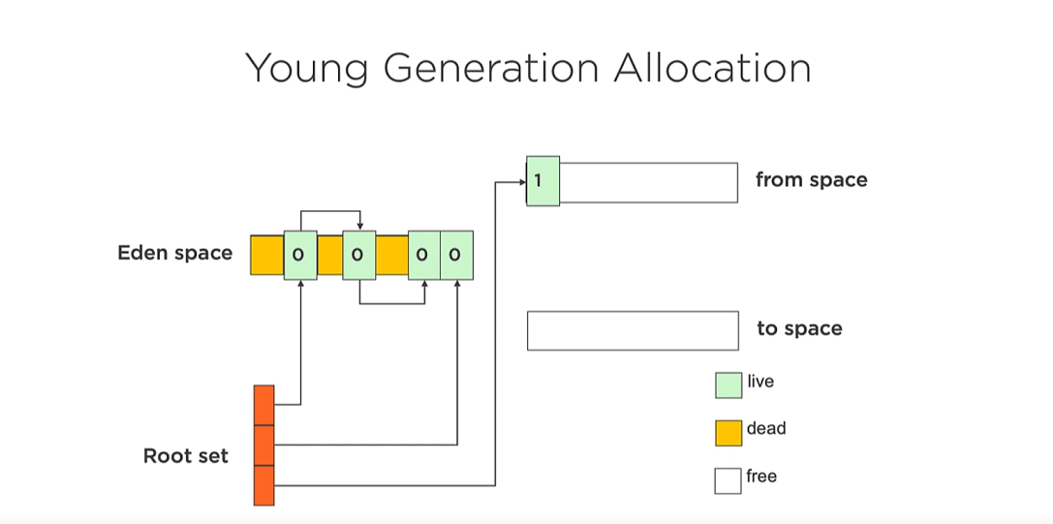

Slide 3
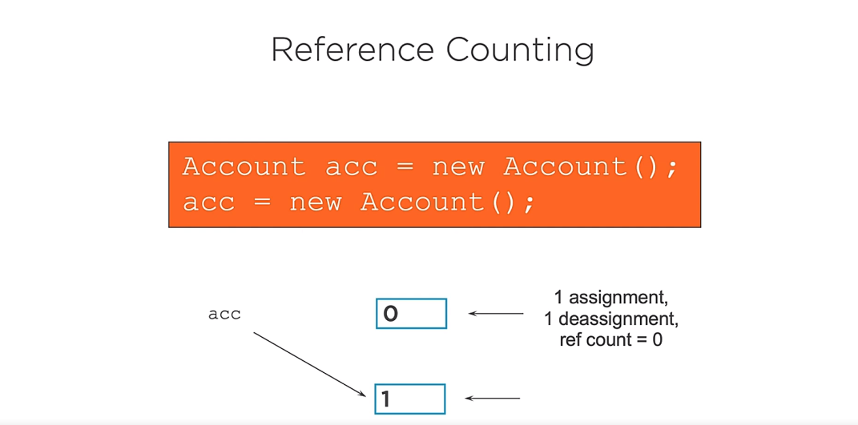

Slide 4
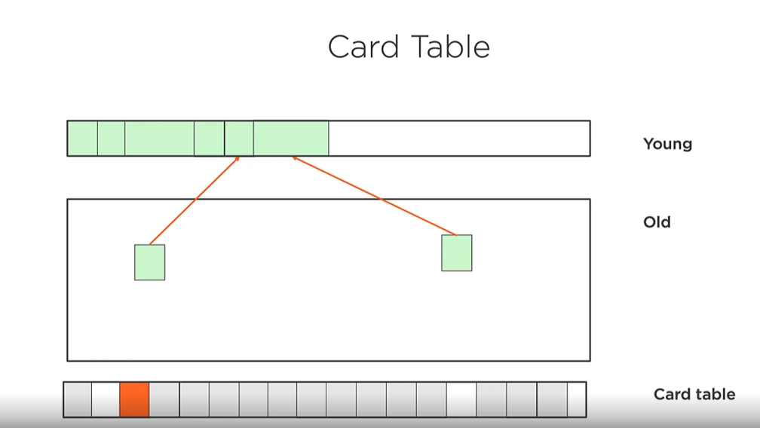

Slide 6


